Slide 1
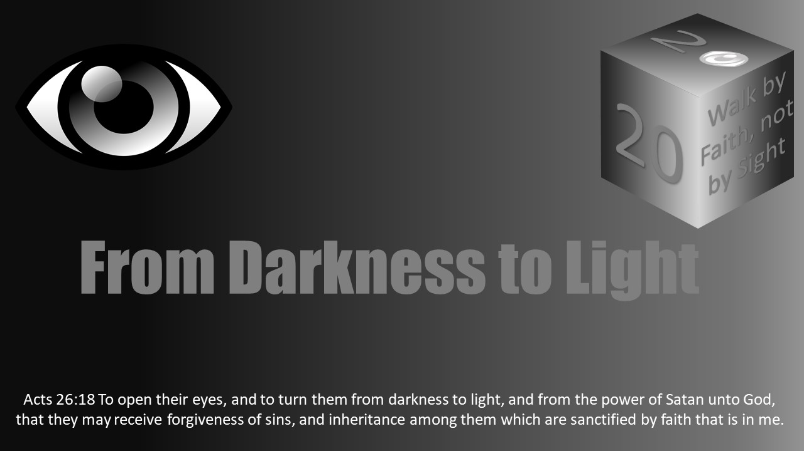


Slide 2
Darkness Lesson 11 The Devil’s Dark Distortions Overcoming Addictions

Slide 3
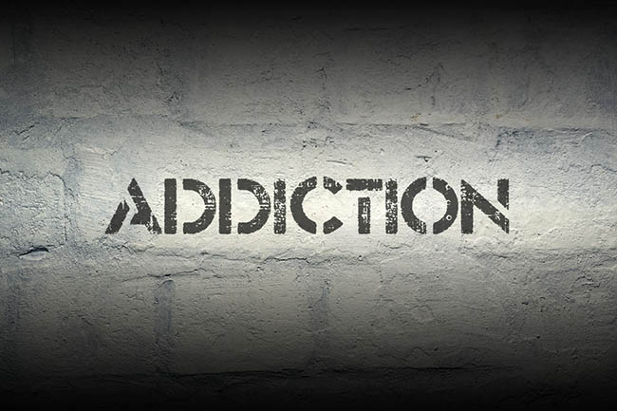
Introduction
One of the devil’s dark distortions to our view of eternity that he uses to enslave us is various addictions.
While usually used in a negative context, the term addiction is actually neutral.
In 1 Corinthians 16:15, the word in the King James Version (KJV) is used in a positive way instructing the Corinthians to be “addicted to the ministry”.
However, for our study today, we will be using the word “addictions” in its usual negative context.

Slide 4

Introduction
Addiction can highjack the brain impacting both behavior and motivation.
In time, a person can become a slave to addiction and can value satisfying the addictive cravings over life itself.
Overcoming the downward spiral of addiction can become one of life’s greatest battles, but God can equip the addict to gain victory and freedom.

Slide 5
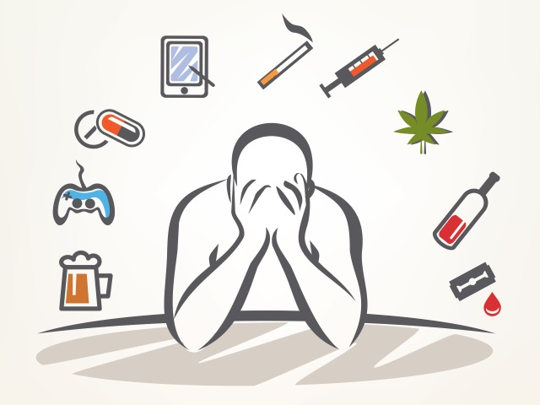
Introduction
In 2013, about 6.6 percent of the U.S. population was dependent on alcohol or had difficulties relating to alcohol use, while more than 24 million people had abused an illicit drug in the prior month, says the National Institute on Drug Abuse (https://www.drugabuse.gov/publications/drugfacts/nationwide-trends).
A Barna study revealed that by self-report 64% of self-identified Christian men view pornography at least monthly with more than 10% admitting to viewing it daily.
Gambling among self-identified Christians is at 61%.
Alcohol/Drug abuse is at 35% with those identifying as “evangelicals/born again”.
While these numbers are alarming, we do not know what the rates are among those we would identify as Christians.
However, we know we have a problem among us. From my clinical interactions with members, I would give a conservative guess of 25-50% of our families are impacted by addiction issues.

Slide 6
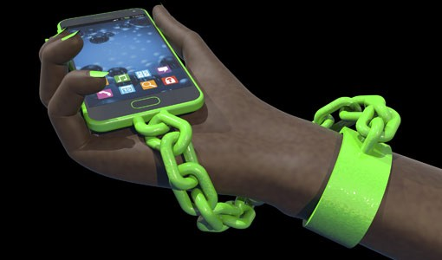
Introduction
When the gospel news is spread and we “go into the highways, byways and hedges”, who comes out?
People with life issues, baggage, and who are damaged by life.
They come for healing and help.
Let us be ready to greet and help.
Sometimes we need a turn, too.

Slide 7
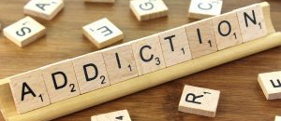
Addiction Defined
The subject of overcoming addiction is complex.
There are no magic answers.
The trip into addiction is the same distance back as it was there.
Effective recovery is individualized. One size does not fit all. Everyone’s recovery is different.
To reach “overcoming,” one must first consider the nature of addiction, types of addictions, how addictions vary in intensity, recovery rates, natural supports and motivations available to the one seeking to overcome.
Once addiction is understood, helpers are in a position to be supportive in the recovery process.

Slide 8
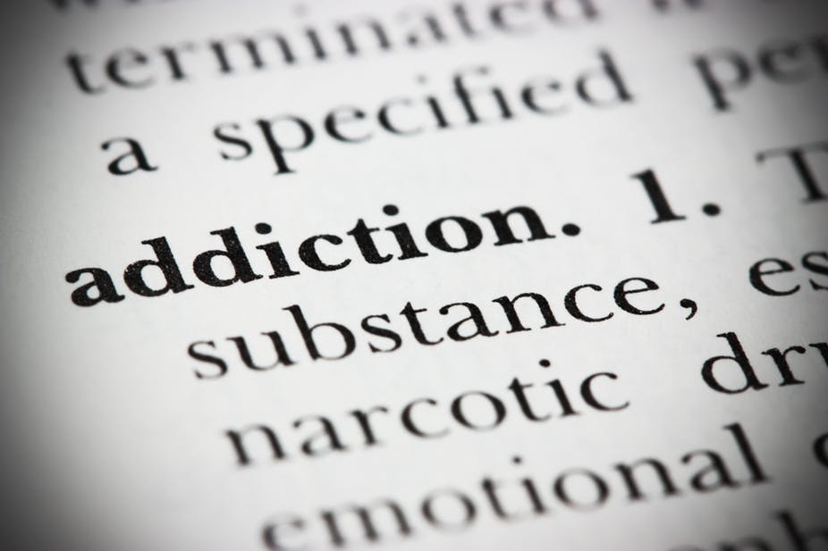
Addiction Defined
What is “addiction”?
Essentially, it is an obsessive/compulsive behavior.
By nature, addictive behavior is progressive. It does not stop where it starts.
Paul emphasized this to Timothy (2 Tim 3:13).
Addiction is a complex series of events which alter the brain’s chemistry usually resulting in devastating consequences.
Multiple brain circuits are affected, and channels are created, including those involved in reward and motivation, learning and memory, and inhibitory control over behavior.
Overstimulating the reward centers and the pain response centers of the brain is key to addiction.

Slide 9

Addiction Defined
The Bible emphasizes things can and often do gain mastery over a person. Consider: Stronghold (2 Cor. 10:4); Devoured (1 Pet 5:8); Drunkenness (Gal 5:19-21); Sorcery/witchcraft (Gal 5:18-21); and Snare of the devil (1 Tim 3:7; 6:9); Deceiver (Prov 20:1).
Addiction keeps some bad company with: Excess of riot (1 Pet 4:4); Fornication/Adultery (Gal 5:19); Lasciviousness (Gal 5:19); Deceptions/Lying (Rom 1:31; Rev 21:8); and Degrading one’s body (1 Cor 6:18-20; Rom 1:21-32).
The intent of this lesson is not to convince the reader addiction (enslavement) is wrong, which it is. Our purpose is to understand addictive processes and to identify ways to counter the progression of the problem.

Slide 10
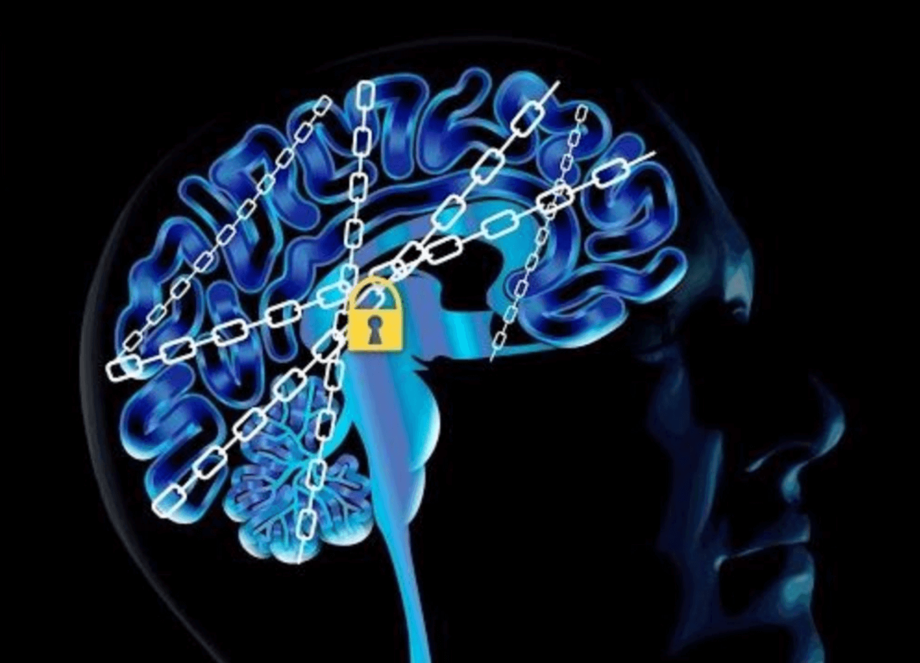
Addiction Defined
Addiction can take many forms and targets many things: chemicals (illicit drugs, prescription drugs, alcohol, over-the-counter drugs, nicotine, food, digital, gambling, sexual, relationship, and shopping/hoarding and more).
The process of addiction is the same regardless of the form.
The rewiring of the brain can be different whether by taking in chemicals or diverting the body’s natural chemistry to over stimulate the pleasure centers of the brain.
The process of triggering the body to release an overabundance of adrenaline, oxytocin, endorphins highs and sedation can become an obsessive behavior. Tricking ones’ body to overproduce natural chemicals can create a natural high and effect which the individual chases.

Slide 11
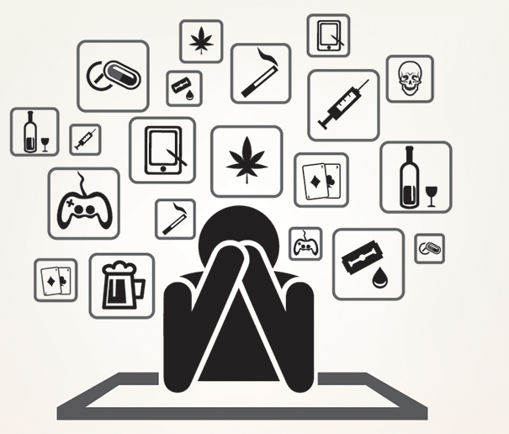
Who Can Become an Addict?
Some people are more vulnerable than others to becoming addicted depending upon genetic makeup, the age of exposure and environmental influences.
While a person initially chooses to feed a behavior to the point of becoming addicted, over time the effects of prolonged exposure on brain functioning compromises their ability to choose.
Thus, seeking and feeding the addiction becomes an obsession and compulsion, often eluding a person’s self-control and will power.
This is to say, satisfying the cravings of the addiction becomes a way of life.
The enslaved person chases the highs and avoids the lows as a way of coping. The dysfunctional behaviors resulting from addiction can interfere with his/her normal functioning in the family, workplace, church and the larger community.
In short, addiction to anything can become an idol to be honored, worshipped and placed above all else in the person’s life.
Idolatry in the form of addiction is, therefore, rampant in our society.

Slide 12

Who Can Become an Addict?
Often people want to ask “why?”
“Why” questions are about who or what to blame, which is a bad approach.
The better and real question is: What? What happened? What prompts a person to become involved in addictive behaviors?
Reasons vary greatly by individual and circumstance: experimenting, family history/genetics, prescription drugs abuse, loneliness, peer pressure, to feel good, mental health disorders, old coping styles stop working, self-medication, grief/loss, trauma.
Addiction is about trying to find something to fill the pain, emptiness, stress or boredom.
It is often about seeking a secular solution to a spiritual problem.
This is why all recovery programs that work have a strong spiritual component.

Slide 13

The Descent Into Addiction
Triggers for addiction can be identified in one of six (6) areas:
loneliness,
angry,
hungry (emptiness of any sort),
tired,
fitting in,
self-medicating.
Weaknesses in these areas must be addressed or they become portals for addictive behavior and/or relapse.
The reader can develop many lessons from the scriptures to show God’s teaching. Keep in mind these six (6) areas are the gateway into the downward spiral.

Slide 14

The Descent Into Addiction
Those seeking to escape addiction frequently ask, “What do I need to change?”
The answer is simple. “Everything”.
I say this because the addicted person usually does not realize the erosion which has taken place in his/her life.
Like the prodigal son of Luke 15, the way back is often more difficult than the way into “riotous living”. Like him, there was a character change and he traded the qualities his father taught him for defects to his character.
Often, addicted persons lose their ability to be thankful and their world becomes one of negativity, chaos, and drama.
This is what happened when we trade godly principles for the devil’s lies.
The path down leads to compromised morals, lies, and deceit.
It also leads to betrayal of relationships, loss of possessions, and loss of focus.
Eventually, nothing becomes more important than the object of ones’ addiction…not even life itself.
The end of the road for the addict is death or insanity.

Slide 15
The Assessment and Criteria
To determine the progression of addiction, the following measures are evaluated:
preoccupation,
inability to control or quit,
continued use despite the consequences,
blackouts,
withdrawal symptoms,
significant distress or impairment in social, occupational or other important areas of life.
Any two of these are sufficient to give a clinical diagnosis of addiction.

Slide 16
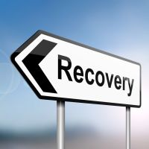
Treatment and Recovery
Treatment and recovery are not simple due to many dimensions and disruptions in the individual’s life.
Effective addiction treatment must help the individual stop the obsessive/compulsive behaviors, address the triggers and cravings, maintain a new lifestyle, restore productive family functioning and give new hope/excitement in life.
At the same time, the individual is changing. The environment in which he/she lives must change to support recovery goals.
This means removal from old playgrounds, playmates and playthings.
It means creating a network of people supportive of the addict without being enablers.
Recovery is hard work and sometimes not very rewarding due to the many bridges that need to be mended and schedules that must be kept in order to support one’s recovery.

Slide 17
Treatment and Recovery
Some Principles of Effective Intervention commonly used in recovery are:
Addiction is complex affecting brain function and behavior.
No single approach is appropriate for everyone.
Treatment needs to be readily available.
To be effective, interventions need to address the multiple needs of the person, not just the substance.
Remaining with help for an adequate period of time is critical.
Approaches need to include individual, family, and groups.
Medications are an important element of treatment for many. Defer to a physician.

Slide 18
Treatment and Recovery
Some Principles of Effective Intervention commonly used in recovery are (cont’d):
Care plans must be modified as necessary to address changing needs.
For most, co-occurring mental disorders must be addressed (whack a mole).
Detoxification should be medically assisted. Alone it does little to change long-term abuse.
Treatment does not need to be voluntary to be effective.
Chemical use during treatment must be monitored continuously.
Treatment programs should test for “high-risk issues” – HIV/AIDS, Hep B and C, TB, STI’s.
Self Help/Peer Lead groups – The experts on addiction are those who have survived and come out of it. Let them lead. Those not in their own recovery can support, guide and direct. Tools that a congregation might consider using in focus groups of people self-identifying with addiction are 12 Step Christianity by Hazelden, Faithful and True Study Workbook, Recovery Coaches, Big Brothers/Sponsor Program, Digital Apps with panic button, and Treatment Programs for referral/consult.

Slide 19


Treatment and Recovery
If your congregation does not want to get involved in peer groups or assignments, find AA, NA, CA, SA, Alanon, Naranon, and Sanon meetings in your area; keep the list handy.
Offer to go with the addict and/or their family to these meetings.
You will learn much by the openness and honesty of these groups.
Be prepared; language can be crude.
Do not miss the jewels because of the mud.

Slide 20
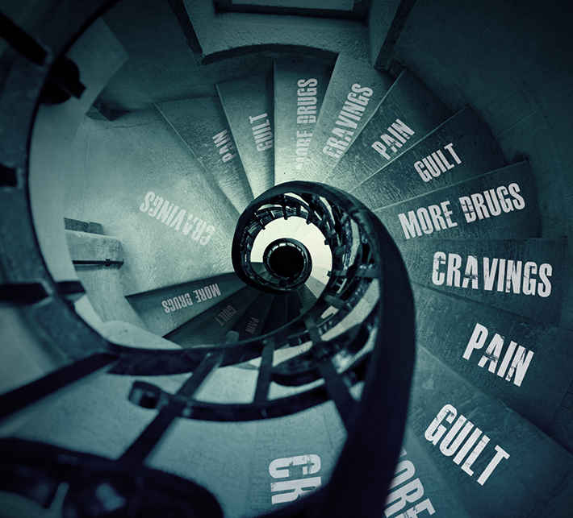


Treatment and Recovery
Families play a large part in the recovery of an addict. Addictions do not happen solo.
Families are changed by the addicted one.
Denial, shame, and guilt often mask the secret life within the walls of homes.
The unspoken rules of “don’t trust, don’t feel, don’t tell, don’t talk” often hide the elephant in the room.
Sunday smiles and handshakes will not fix this problem.
We get sick when we keep secrets. But, where is it safe to talk about what is hurting us…our pain? Is it safe to share issues where you worship? What is happening in our churches filled with people?

Slide 21

Some ways individuals can help:
Families and friends need to take care of their own health so they can provide the addicted person help in healing. Sometimes the “sickest” person in the family is not the addict. Look for opportunities with the whole family.
Squelch gossip, talebearing, and backbiting. Where such is present healing cannot occur.
Learn as much as possible about addiction. Every day, research teams learn more about how addiction interacts with the cells inside the brain. That knowledge is used to develop new treatments. Education can help families to escape the blame game. Rather than seeing the addiction stemming from weakness, willfulness, or stubbornness, they might learn how addictions stem from changes in brain chemistry and electrical impulse alterations. Anger does not change that. Ranting will not fix the problem, but it will frustrate the recovery.

Slide 22
Some ways individuals can help:
Connect with understanding peers. Living with an addict is not easy. Support is needed. Mistrust runs rampant in every member of a family touched by addiction. Connecting with peers may help (programs like SA, Sanon, Al-Anon, Naranon, or Alateen, GA, and others). The idea here is to provide help for families of addicts/ alcoholics. These programs provide a safe, nonjudgmental space for family members to learn, discuss and overcome an addiction. Congregations might consider offering support groups for the members.
In a survey published in the Journal of Studies on Alcohol and Drugs (https://www.ncbi.nlm.nih.gov/pmc/articles/PMC3817053/), participants reported they were drawn to meetings hoping to find help with: better quality of life, fewer problems with the addicted person, lower stress levels, and improved psychological health.
I would add improved spirituality can come from these meetings as brethren share and help “bear one another’s burdens” (Gal 6). In these meetings are people with the problem showing others behind them the way through the problem. There is power in telling our story and sharing our journey as Paul did in Acts 9, 22, 26.

Slide 23
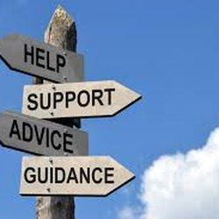
Some ways individuals can help:
Encourage family members to go to family therapy sessions. Dealing with an addict is never easy. The nature of addiction is it not only changes the addict – it changes the family, too. Family members can become distant. Often, they do not talk openly. They become strangers marked by avoidant behavior and living in guilt, blame and shame. Coping tools are needed to assist someone into active recovery. The family may have lost its way. A goal of therapy is to assist the family in supporting one another, come what may.
Prepare meals and eat them as a family. While schedules can get tight, a family meal allows everyone in the family to reconnect at the end of a day. Each meal helps to establish a ritual and a connectedness.
Manage expectations – It can take a long time for patterns to change. Do not allow yourself to “get weary in well-doing” (Gal 6). Sometimes the slow shift leads to discouragement and disappointments. Recovery often involves relapses. Be patient and helpful.

Slide 24

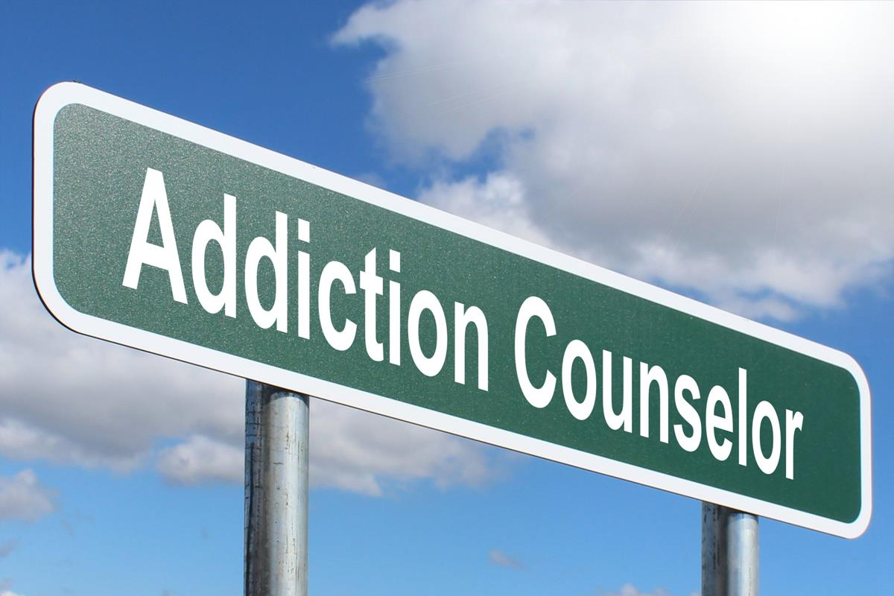
How the Church Can Help
Linking to resources – Develop a list of church resources and community resources. You can do this by connecting with your local United Way either online or in person and printing out the thick list. Ask other churches (more conservative) who they refer to. Interview the team you want to refer to for treatment. They will be more than happy to develop you as a referral source. Identify where community meetings are happening (check with the Board of Health or United Way). Those meetings will keep you informed about what is happening in your community and are nice tools for evangelism and tours of their facilities.
Know your limits and boundaries (avoiding codependency/enabling). When do we need to refer? To whom do we refer?

Slide 25

How the Church Can Help
Get educated about addiction – Addiction may be masking an even larger problem such as underlying emotional issues, chemical imbalance, depression, anxiety, bipolar, eating disorder or other disorders that cause a person to self-medicate.
Offer support, but do not enable – Enabling a member’s addiction can come in many forms. Enabling behaviors help the addict or alcoholic remain sick. Enabling can be anything from letting the “using” member live in your home and continue their behaviors while there, or it could be something as simple as making excuses for the person. Other examples might be bailing them out of jail, paying their bills while they continue their addictive behaviors and more.
Avoid supporting the addiction financially – When a drug-addicted member asks for money, has you pay their bills or even lives in your home rent-free, this may be enabling their addiction. The member may give many reasons why they are asking you for money, but unfortunately, all paths likely lead to supporting the drug/alcohol use financially.

Slide 26

How the Church Can Help
Establish boundaries and stick to them – Once you have decided you will not be a part of their addiction but will be a part of their recovery, then you have to set boundaries. Coming to this point is likely one of the hardest things to do. Enforcing those boundaries is just as hard. Be realistic about your boundaries and be willing to follow through on any boundary you set. These boundaries are set in place to protect you and your families.
To help them, you must help yourself. The recovery and healing process are as much for the member as it is for you and other members. Addiction affects family relationships in different ways. Being a part of the solution rather than a part of the problem is critical to family recovery.
Do not let their addiction struggles take over your life – Sometimes one’s addiction can consume your life and swallow up your time and energy. Love the addict but take care of yourself and give time to other family members. You do this by carrying on with your regular life, work and interests, taking time to care for yourself. Their addiction is their addiction (not yours) and their recovery is their recovery (not yours).

Slide 27

How the Church Can Help
Avoid lecturing/guilt/intimidation – Complicated family relationships and issues are sometimes a factor in destructive addictive behaviors. Making your member feel hurt, scared or undermined can only aggravate the situation and cause a vicious cycle of more self-medication. Treatment and recovery require love, support, and empathy, but also willingness by the addict.
Look into professional treatment and rehabilitation service options – Likely the addict and the brethren do not even know where to begin or what options are out there for them to get help. In fact, the addict/alcoholic may not even want to hear about options. So when you suggest options, they may be shot down. Keep 211 in mind. It is the national mental health and addictions resource line manned 24/7.
Treatment ranges from individual therapy sessions to clinical groups, to inpatient detoxification and rehabilitation and/or residential treatment. Peer support (which is not treatment) is seen in group meetings such as alcoholics anonymous, narcotics anonymous, cocaine anonymous, and other community groups. I strongly suggest helpers visit one or more of these groups in their “open” meeting. “Open” means anyone may attend whether they have a substance problem or not. In particularly difficult cases, intervention may be staged to coerce the member into accepting treatment.

Slide 28
How the Church Can Help
Encourage them to seek help – Trust is a key factor in getting a member into treatment. Encouragement happens when one takes an objective approach to the problem and taking a position to assist the member in starting to get help.
Be involved in the rehab treatment and recovery process – Healing from alcohol and drug addiction is everyone’s responsibility. If a person is on the road to recovery and the members have not taken steps to be a part of the healing process, this can actually hinder the addict/alcoholic’s recovery process. Often, addiction is a deep-seated family issue. Learned behaviors within the home may be a barrier if the family has not begun their own recovery processes. When a person goes to treatment and then returns to the same environment that made him/her sick, they are likely to revert to old behaviors. Recovery means the entire family unit needs to be in recovery.

Slide 29
Suggestions:
Know your limits and where to refer within your community. Be wise. Think before you act.
Keep the problem where it belongs. The addicts’ problem is the addicts’ problem…not yours. You did not create the problem, and you cannot fix it. You can coach and encourage. Do not let his/her problem become yours. Be a part of the solution, not part of the problem.
Remember, “Be sober, be vigilant; because your adversary the devil, as a roaring lion, walks about, seeking whom he may devour” (I Pet 5:8). Be careful. When helping people out of the pit, you must be careful they don’t pull you in the pit with them.
Contact https://www.leavingthepitbehind.org for more help and resources.

Slide 30
References
Beattie, Melody. Codependent No More & Beyond Codependency. New York: MJF Books, 1989.
Erickson, Carlton K. Addiction Essentials. The Go-To Guide for Clinicians and Patients. University of Texas at Austin. Austin Texas: 2011
Hvaas, Sheryl Ramstad, et al. Criminal and Addictive Thinking. Center City, MN: Hazelden Foundation: 2002.
Larsen, Earnie. Now that You’re Sober. Center City: Minneapolis, MN, Hazelden: 2010
Marlatt, G. and Gordon, J.R., eds. Relapse Prevention: Maintenance Strategies in the Treatment of Addictive Behaviors. New York: Guilford Press, 1985
Miller, W.R. Motivational interviewing: research, practice, and puzzles. Addictive Behaviors 61(6): 835-842, 1996.
Najavits, Lisa M. PhD. A Woman’s Addiction Workbook, Oakland, CA: New Harbinger Publications, Inc. 2002.
National Institute on Drug Abuse. Principles of Drug Addiction Treatment: Washington, DC, 2000.
The Staying Sober Workbook. Gorski, Terrence. Herald House/Independence Press. Independence, MO. 1992
Art Adams can be contacted at: artadams3049@yahoo.com or by texting him at 574-229-7983. His address is 10560 Lookout Lane, Indianapolis, IN 46234

